Slide 1
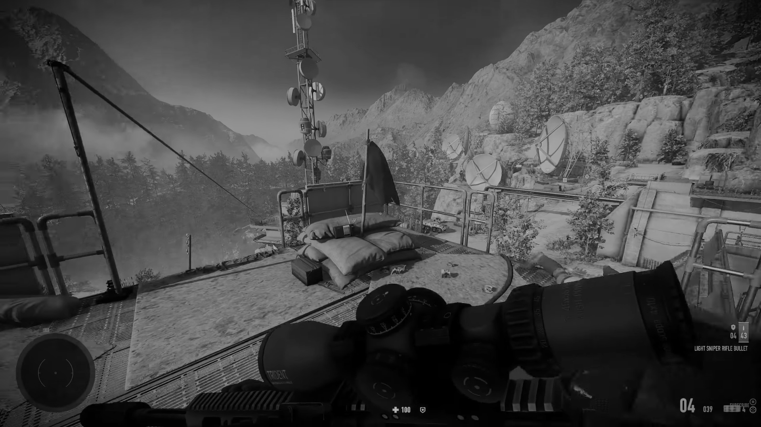

CounterForce
Operations

Slide 2
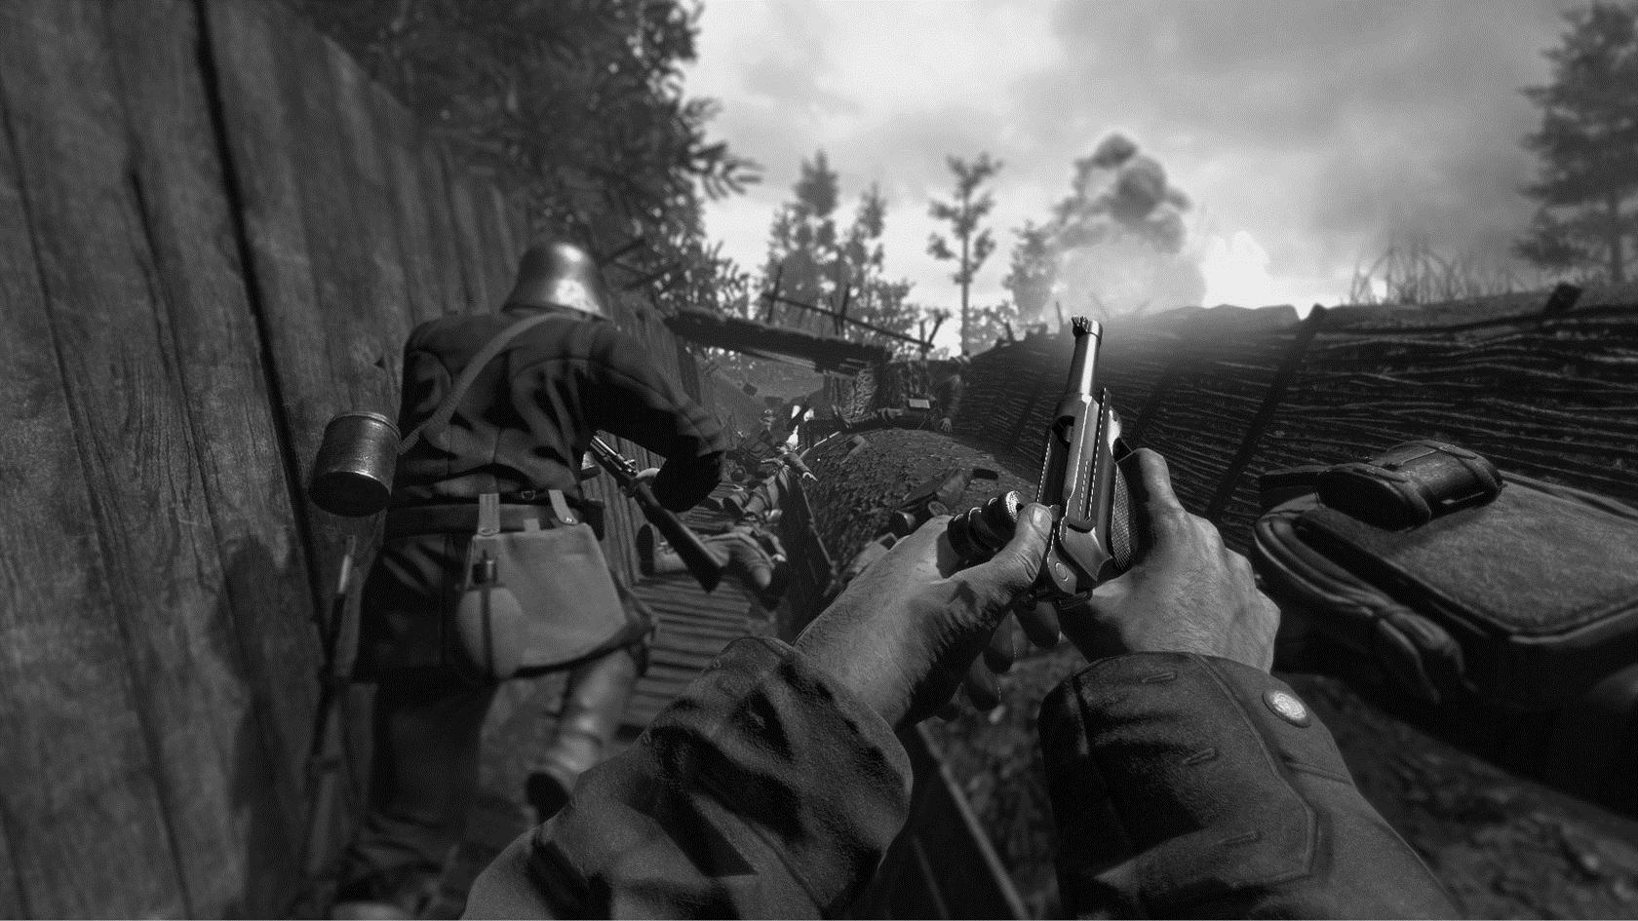
INTRODUCTION
Welcome to "Counterforce Ops: Bloodline," a web-based game developed for the Continuous Assessment-2 of Front-end Web Development. This game is built using vanilla HTML, CSS, and JavaScript, providing an engaging experience for both laptop and mobile users.

Slide 3

What's the Game About?
"Counterforce Ops: Bloodline" follows Jake "Raptor" Mitchell, a seasoned operative. As global unrest escalates, Phoenix Dawn emerges, threatening a deadly bioweapon. Jake, driven by personal stakes, infiltrates the group to stop the catastrophe and save his estranged brother, Ethan. Navigate moral complexities, make critical choices, and uncover the thin line between hero and antihero. Can Jake prevent disaster and save his family, or will he face the ultimate sacrifice for the greater good? The game is a gripping tale of family, betrayal, and the cost of war.

Slide 4

Features:
Instruction Section
Responsive Design
Score Calculation
Audio Integration
Game Over Screen
The gaming experience kicks off with an instructional segment, allowing players to delve into the captivating story, ensuring a seamless and enjoyable gameplay experience.

Slide 5
Features:
Instruction Section
Responsive Design
Score Calculation
Audio Integration
Game Over Screen
The game is designed to be accessible and enjoyable on both laptop and mobile devices.

Slide 6
Features:
Instruction Section
Responsive Design
Score Calculation
Audio Integration
Game Over Screen
The player's score is calculated and stored using JavaScript Storage, providing a persistent record of their performance.

Slide 7
Features:
Instruction Section
Responsive Design
Score Calculation
Audio Integration
Game Over Screen
Background music and sound effects enhance the gaming experience, providing auditory feedback and immersion.

Slide 8
Features:
Instruction Section
Responsive Design
Score Calculation
Audio Integration
Game Over Screen
Upon completion of the game, the player is presented with specific phrases for winning and losing.

Slide 9
DELIVERABLES
Project link: Click here
Deployed link: Click here

Slide 10


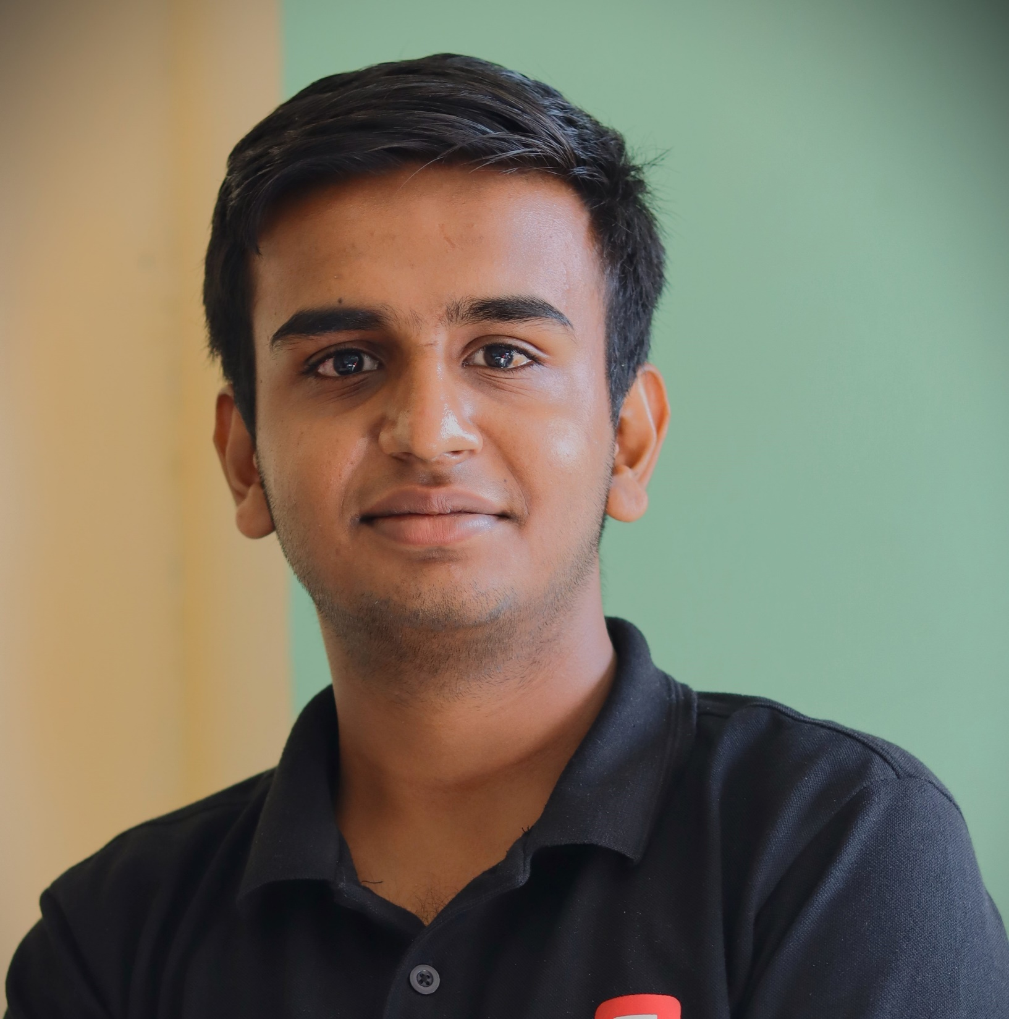



Thank you!
Aman Agrawal
Squad 59
Chitkara University,
Himachal Pradesh

